Slide 1
Movie Master
A BROWSER based Movie quiz application
Team Z: HarRiët, Areg, David

Slide 2
Demo

Slide 3
The product backlog
Implemented user stories (Mimimum Viable Product):
Login & authorization token
Start quiz
Different question types
Show questions & (unique) answer options
Show aggregate quiz results
Nice to haves:
Show correct/false questions at the end of the quiz
Game history for each profile
Two player mode
…

Slide 4
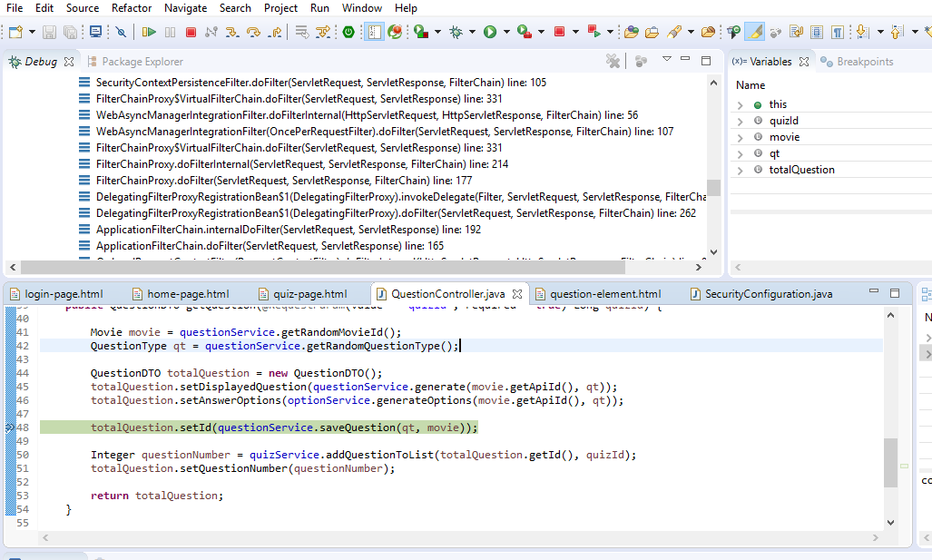
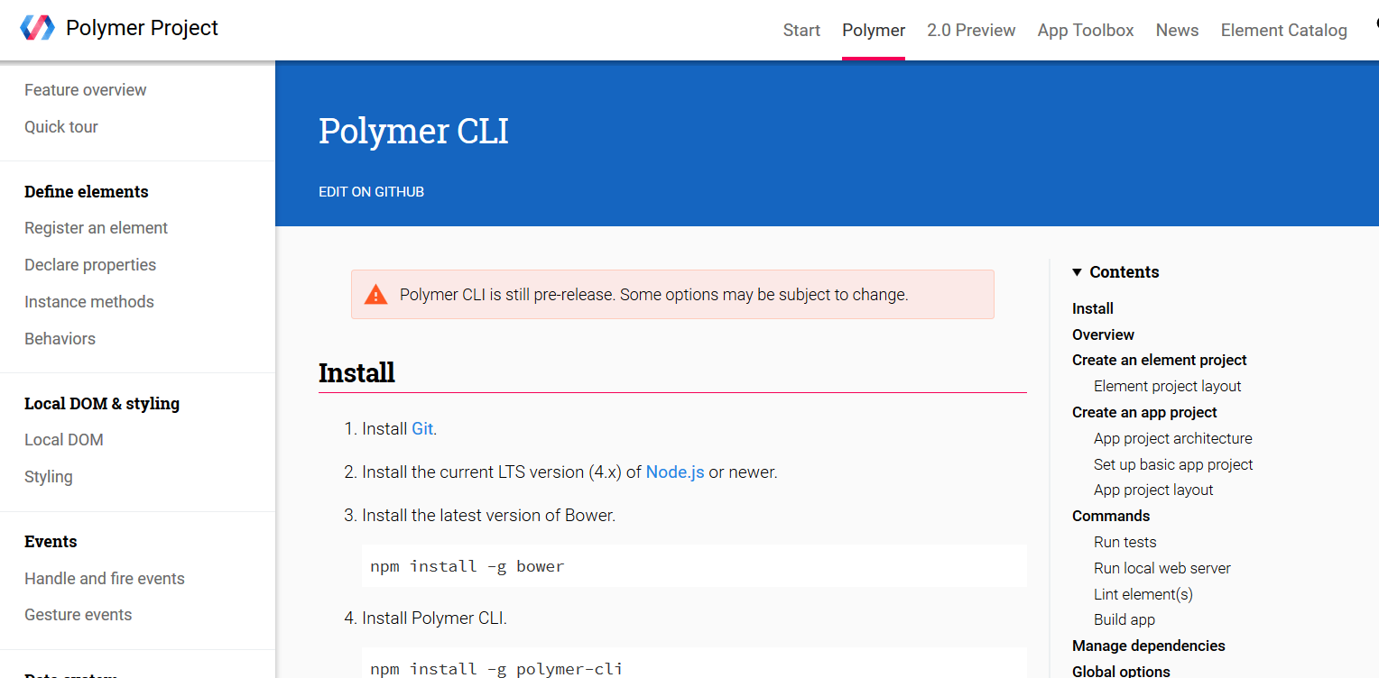
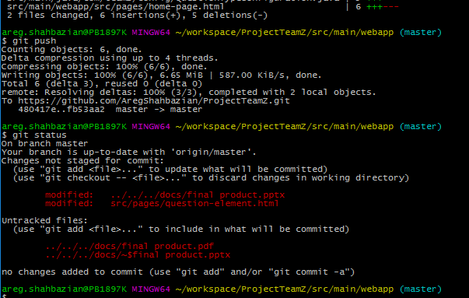
STACK
Spring Framework
Spring data: repositories, hibernate, MySQL as database
Spring REST: Services, controllers
Spring security: JWT based security
Browser based frontend
HTML
CSS
Javascript
Polymer: Ajax, styling
Tools
Eclipse - Spring Tool Suite
Git
MySql Workbench

Slide 5
System Architecture
Repositories
Movie
QuestionType
Question
Quiz
Services
Question
Quiz
Option
Controllers
Question
Quiz
Frontend
Polymer
MySQL
Datebase
JSON { }
JSON { }
Movie API

Slide 6
Data MOdel
Question Type
1
0..*
Quiz
Question
1
0..*
0..*
1
Movie

Slide 7
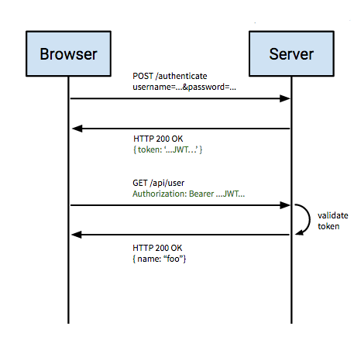
Security features
Authorization using JWT (JSON Web Token)
Token generation using secret key
Local storage of token using cookies
Token lifetime

Slide 8
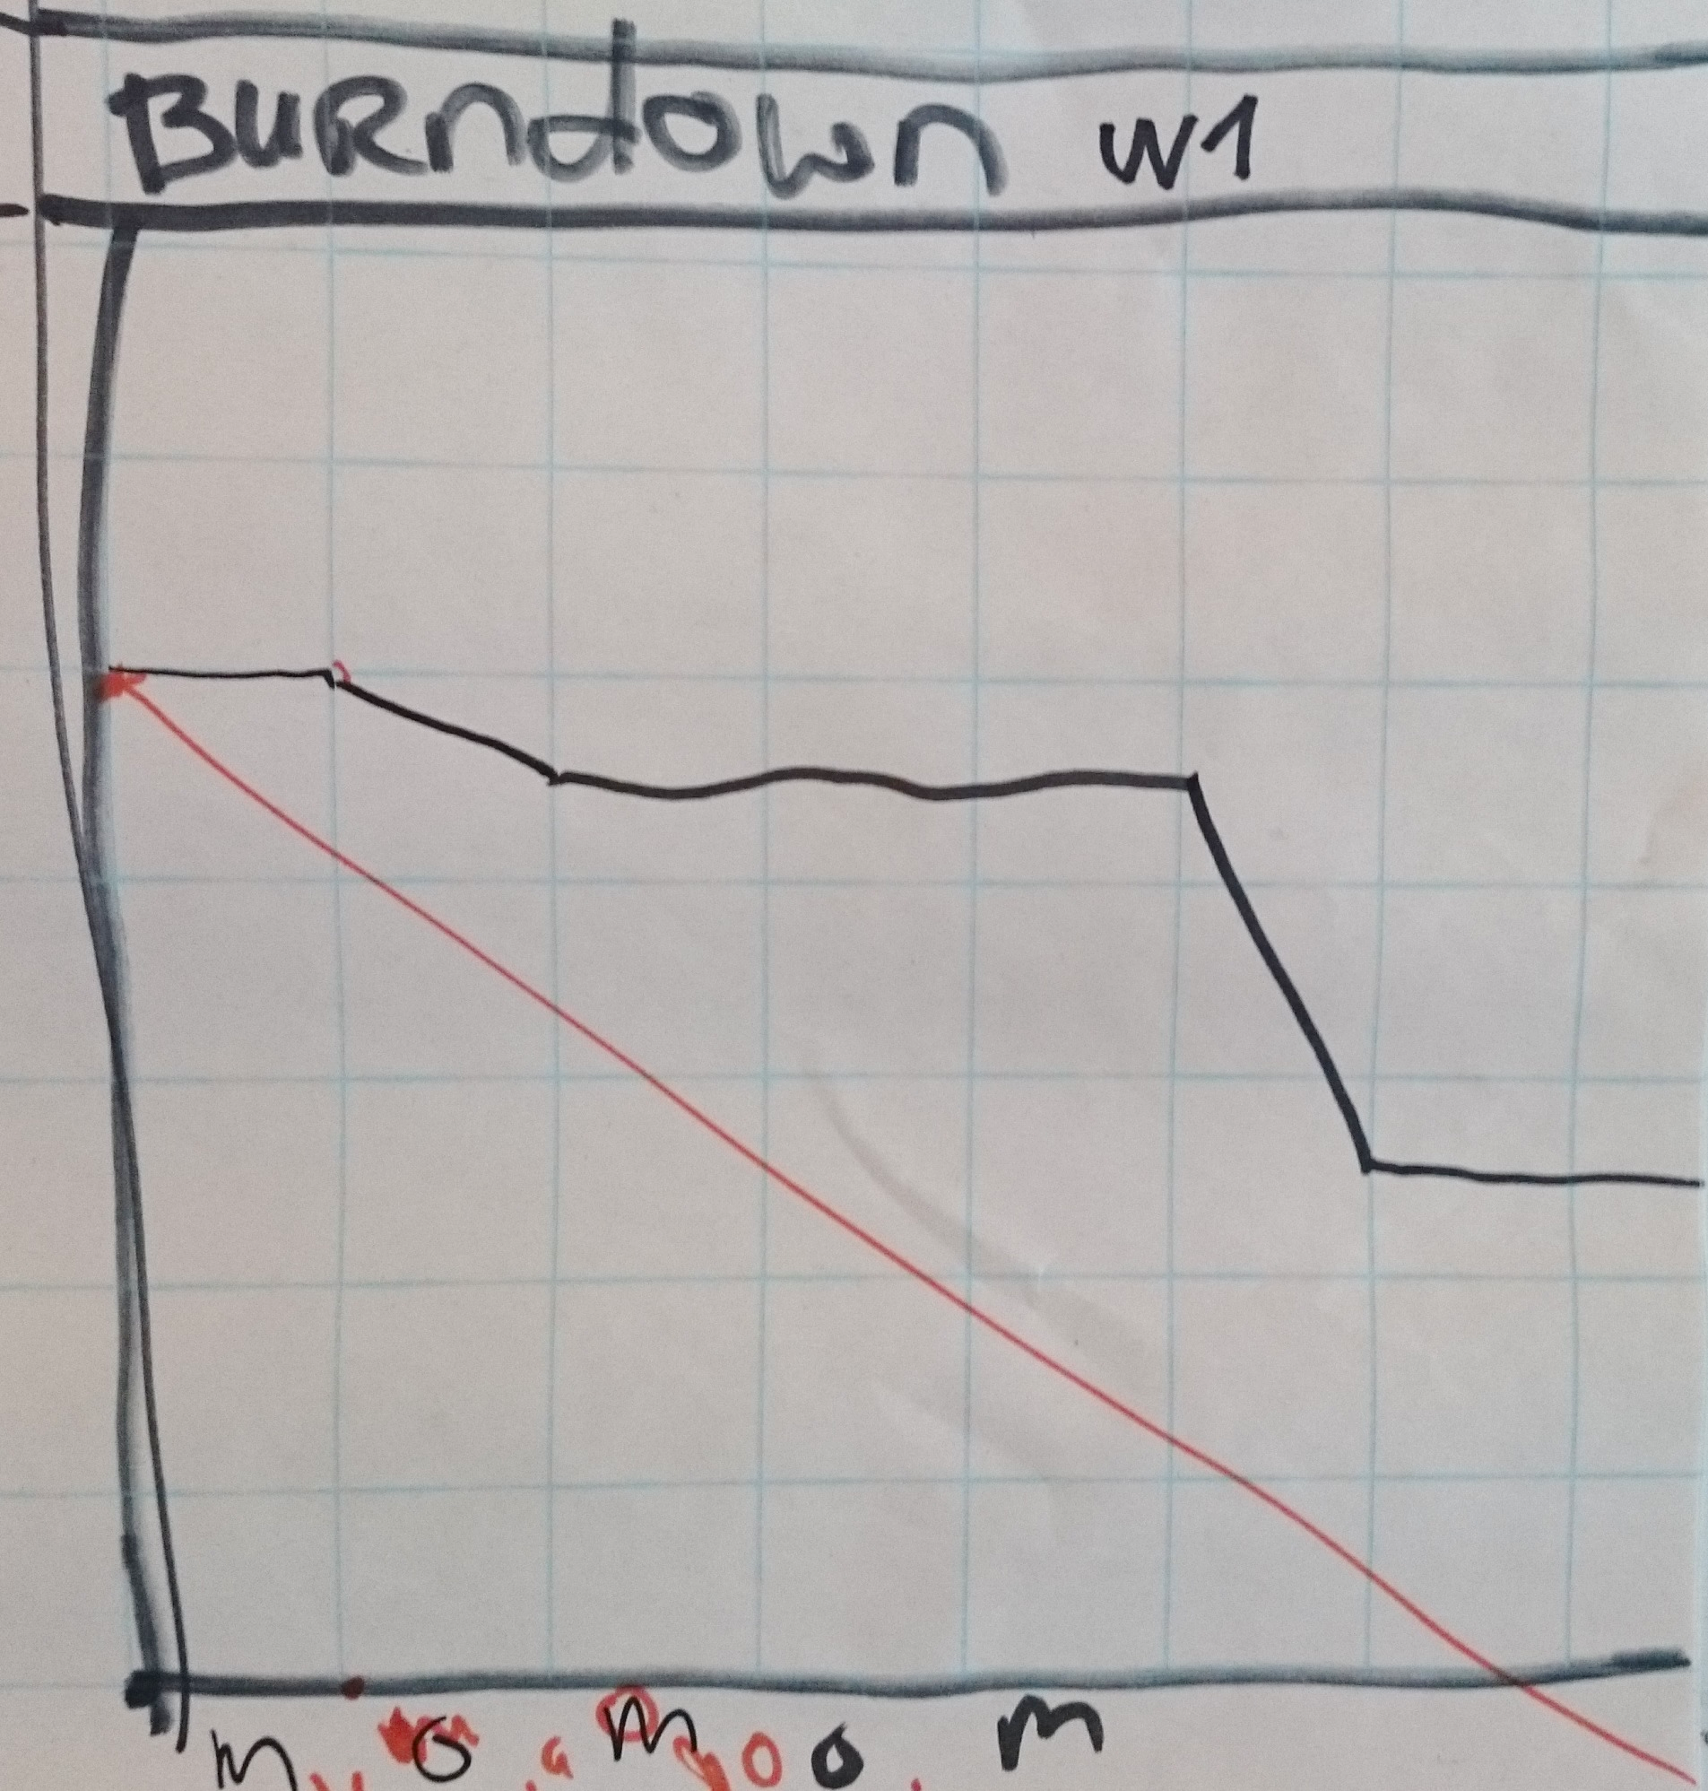
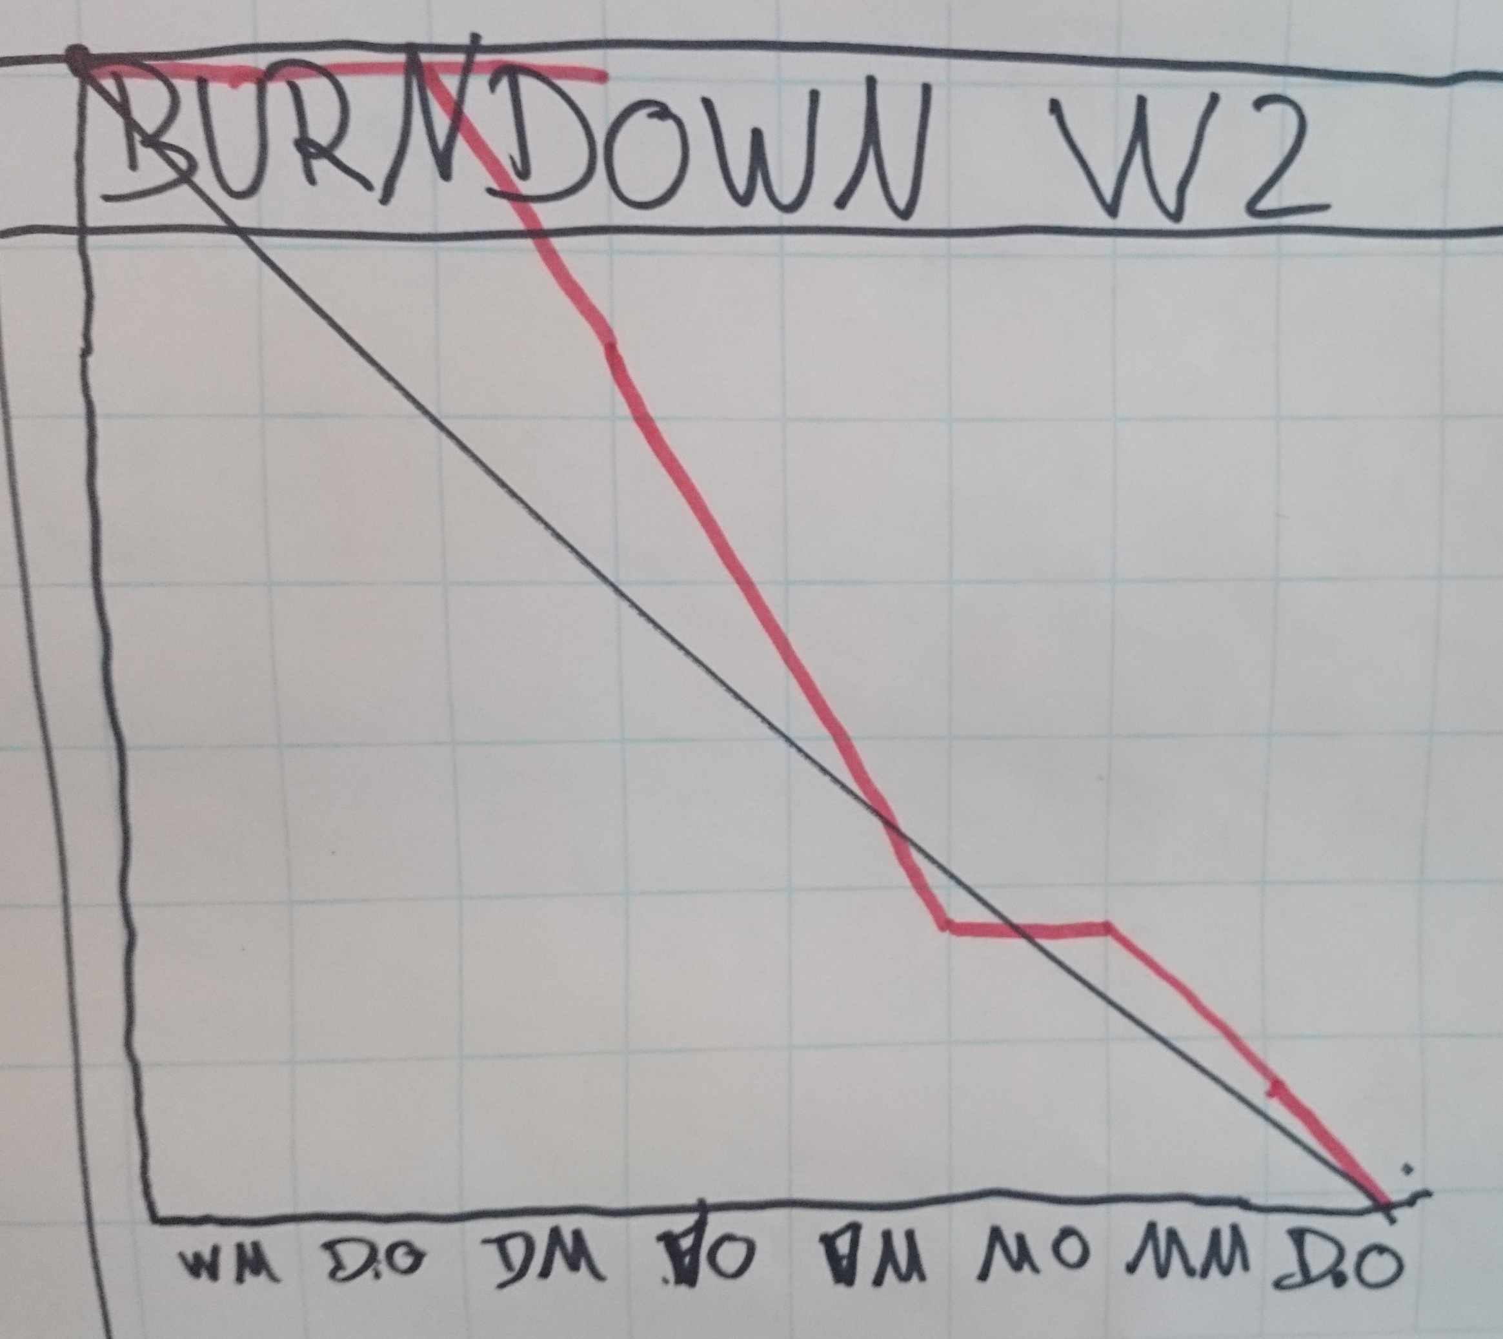
Sprint reviews
Sprint 1
Sprint 2
Improvements during second sprint
More manageable user stories
Defining tasks during sprint planning
Ideal
Actual
# story points
# story points
Ideal
Actual
Time
Time

Slide 9
Lessons learned
SCRUM process
Architecture of web application (controllers, services, repositories, configurations)
RESTful design
Test Driven Development
Working with a Java framework
Working with a frontend-framework
Using an IDE
Using Git

